Slide 1
Secure-Data-Hiding-In-Image-Using-Steganography
CAPSTONE PROJECT
Presented By: SHRAJAL JHARIYA
Student Name: SHRAJAL JHARIYA
College Name & Department : Guru Ghasidas Vishwavidyalya, Bilaspur (C.G)
Department of CSIT

Slide 2
OUTLINE
Problem Statement
Technology used
Wow factor
End users
Result
Conclusion
Git-hub Link
Future scope

Slide 3
Problem Statement
With the increasing threats to digital communication, securing sensitive information is a major concern. Traditional encryption techniques secure data but also indicate that secret information exists. Steganography addresses this issue by hiding information within images, making it undetectable to an unintended viewer. This project implements a steganography tool to securely embed and retrieve secret messages within images using encryption

Slide 4
Technology used
Programming Language: Python
GUI Framework: CustomTkinter
Image Processing: PIL (Pillow)
Encryption Method: LSB (Least Significant Bit) Steganography
File Handling: OS and Tkinter file dialogue,

Slide 5
Wow factors
User-Friendly Interface: A modern GUI with toggle functionality for encryption and decryption.
Dual Security: Message encryption before embedding in an image.
Key-Based Security: Only authorized users with the correct key can extract hidden messages.
Image Preview: Shows uploaded image before processing.
Portable: Lightweight and easy to use for secure communication.

Slide 6
End users
Government and intelligence agencies for confidential data exchange.
Journalists and whistleblowers for secure message transmission.
Businesses to protect sensitive documents.
Individuals seeking secure communication over the Internet.

Slide 7
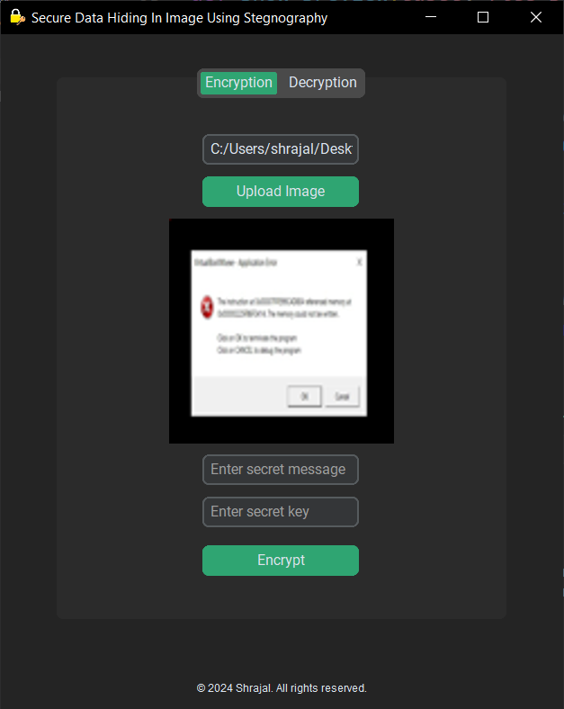
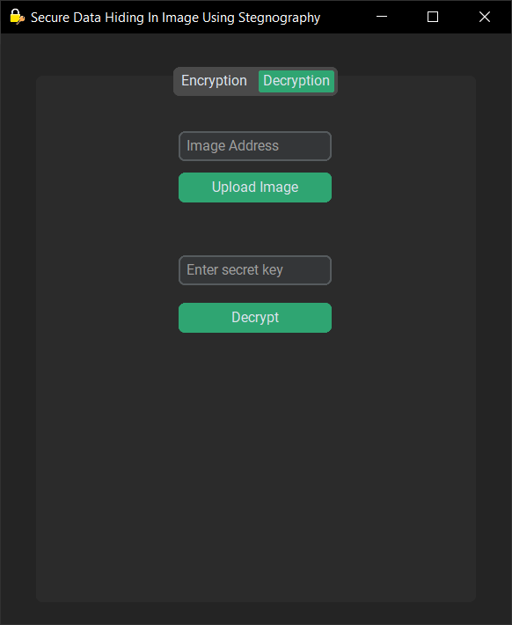
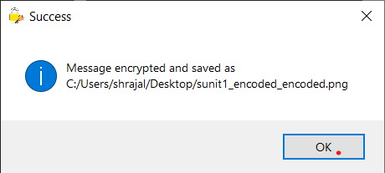
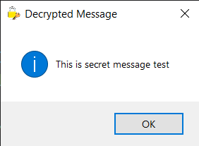
Results

Slide 8
Conclusion
This steganography application ensures secure data transmission without raising suspicion. By integrating encryption with steganography, we enhance security and provide a reliable method for confidential communication

Slide 9
GitHub Link
https://github.com/SHRAJALJHARIYA/Secure-Data-Hiding-In-Image-Using-Steganography
Secure-Data-Hiding-In-Image-Using-Steganography

Slide 10
Future scope(optional)
Implement advanced encryption algorithms (AES, RSA) for added security.
Support for multiple image formats (JPEG, BMP).
Mobile application version for on-the-go secure communication.
AI-based steganalysis to detect and prevent unauthorized steganography.

Slide 11
THANK YOU

